Slide 1
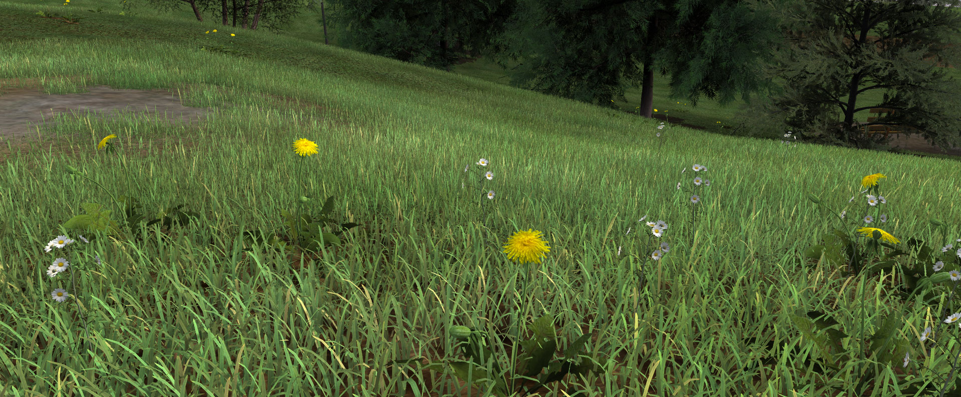
Introduction to Computer Graphics: Grass Rendering
Colussi Maëlle, Vandroux Lucas, David Raphaël

Slide 2
Goal of our project:
Create a realistic grass rendering in realtime.
Idea from the work of Kevin Boulanger:
http://www.kevinboulanger.net/grass.html

Slide 3
Implementation:
Need to create a particles system
For each particle, a blade of grass would be added
Each blade of grass would consist of two crossed billboard planes with a grass texture

Slide 4
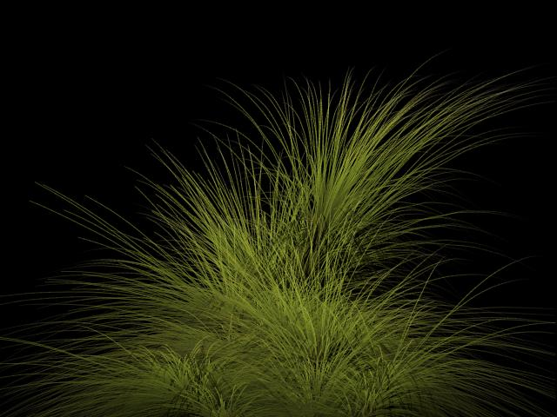
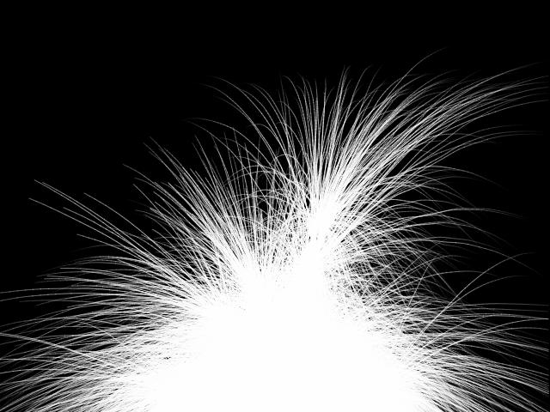
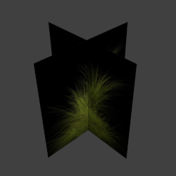
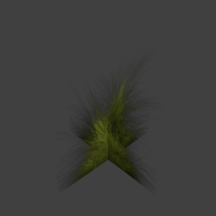
+
=>

Slide 5
Idea behind the particle system:
We do not want to store each particle in an external file and then load them. We want to generate them.
This can be done by using a small pattern of particles (no more than 25) in a .obj file.
This pattern would be placed at the beginning of the terrain plane.
At every step, we draw the particles in an array, translate the pattern and do it again.

Slide 6
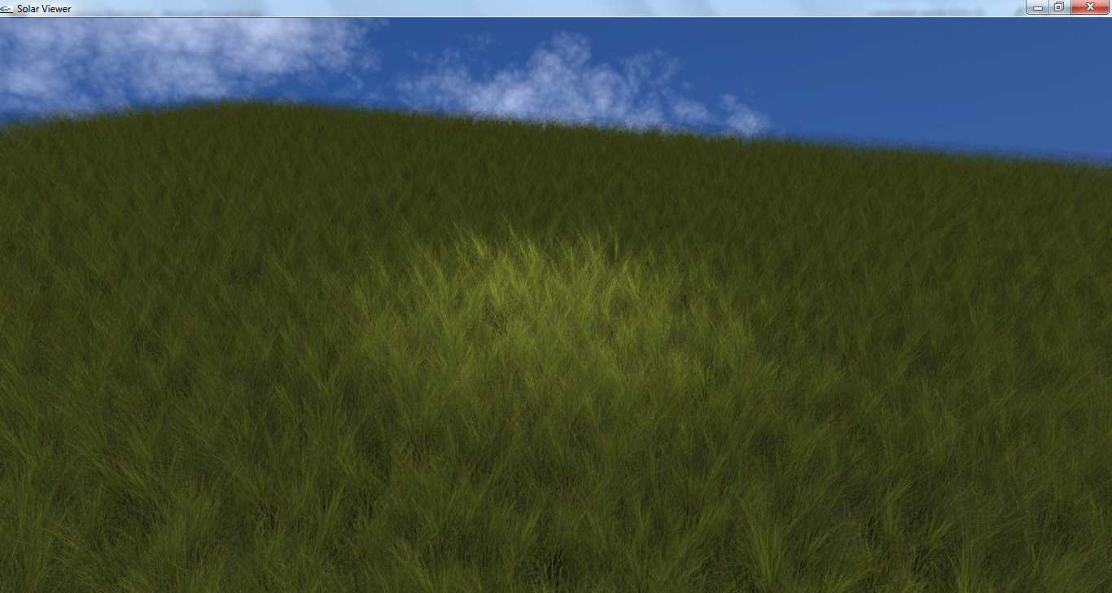
Our result until now:

Slide 7
Difficulties found:
Flickering:
Our project uses multisampling, which is an anti-aliasing that only deals with edges.
Our grass is a texture on a plane.
=> the grass isn’t anti-aliased.
Solution: use alpha to coverage (algorithm that transform the anti-aliasing such that it is no more based on the primitive’s edges, but on the alpha values of the fragments.

Slide 8
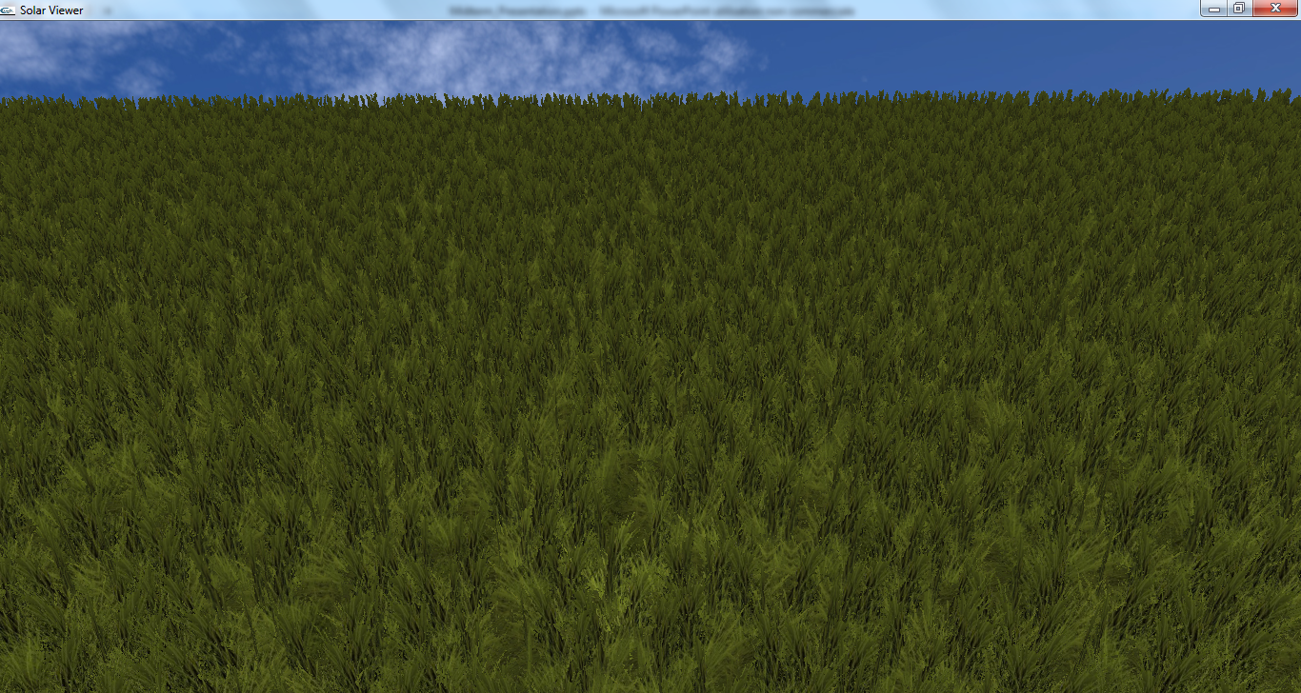
Without the alpha to coverage: the fragments that have a small alpha value are just discards

Slide 9
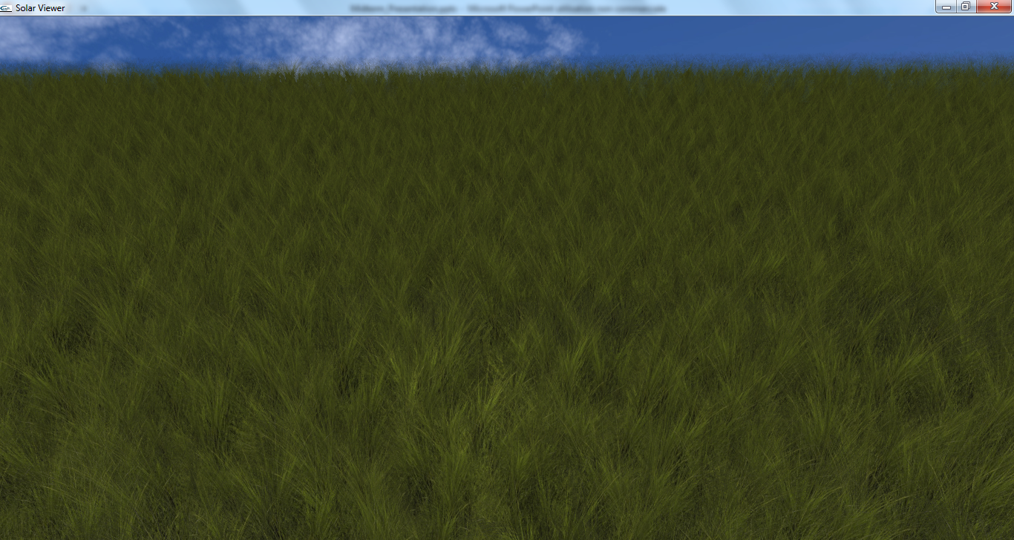
With the alpha to coverage: the anti-aliasing is applied according to the alpha values.

Slide 10
For the future:
We will add the possibility to change the density of blind of grass for a specific area
We will run our algorithm a second time to generate flowers.
If we will have time, we will try to add the possibility to have a non planar terrain.

Slide 11
Questions?

